Slide 1


Course Final Game Computer Science Department Second Semester 2017/2018 Comp2351 – MOBILE GAME PROGRAMMING Instructor: Dr Yousef Hassonah
By: Elias Shbaitah #1141882 Mohammed Hammayel #1141885 Anas Hwiti #1140123

Slide 2
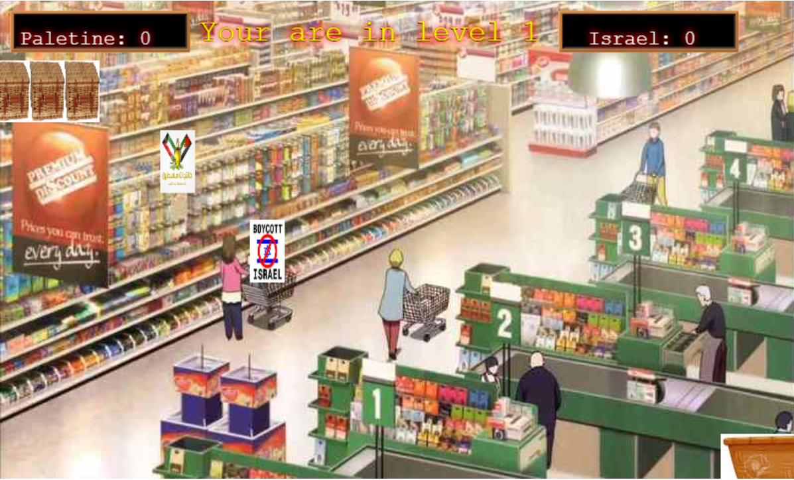
Game Introduction the game mainly is an idea of collecting products 1) Palestinian products 2) Israeli products so the game will be featuring 1) products sprites 2) the collector sprite 3) levels based on velocity

Slide 3


Gamification
Definition: The application of typical elements of game playing to other areas of activity, typically as an online marketing technique to encourage engagement with a product or service.
In Cutoff Israeli product game the gamification is to encourage the local Palestinian products and warn the user of buying Israeli products, for each Palestinian product collect ,it mean he saved one person.

Slide 4


Game elements
Elements:
Palestinian score
Israeli score
Palestinian products sprite
Israeli products sprite
Basket to collect products sprite
Background sprite
sounds

Slide 5

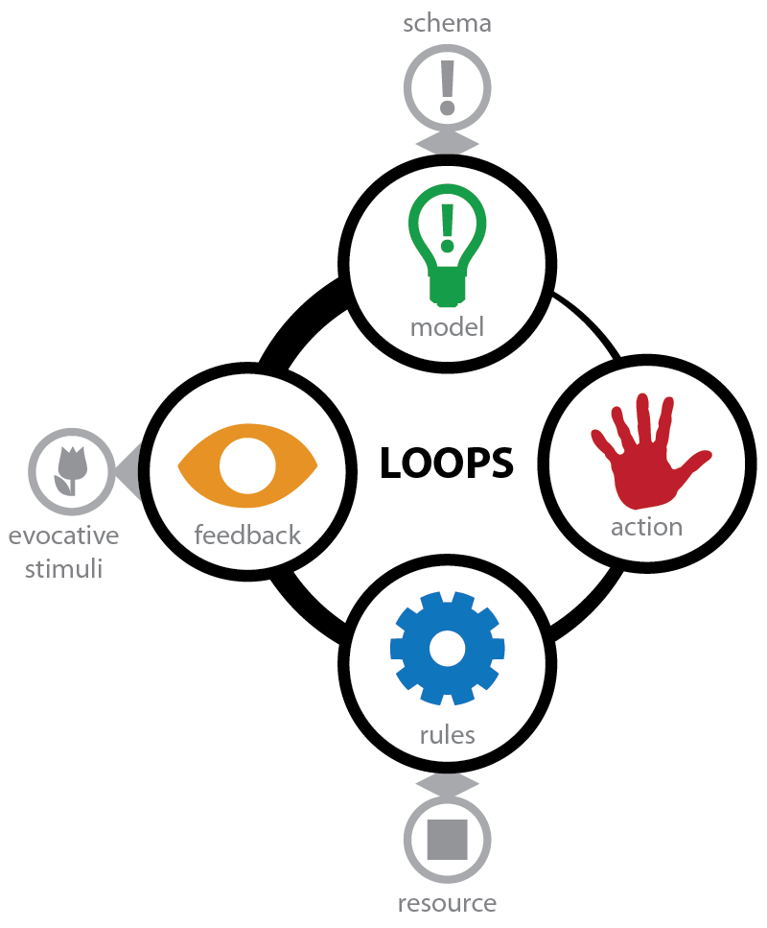
Game loop
The game loop mainly consists of:
Update: which updates the basket position and the speed of products.
Handling the basket inputs
Drawing the Game

Slide 6
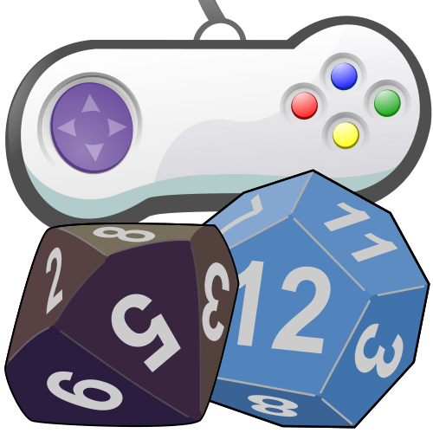

Score and Rules
Rules : levels depend on equation of velocity, each level is finished when the lives end, and there is 3 lives depending on the user faction we decrement the lives so if the Palestinian score is highest the user loses a life when a Palestinian product hits the floor and vise versa.
Score : in this game we introduce two score one for Palestinian products and one for Israeli products each product type adds increases score to one of the scores…. why is that ? We will explain in the rewards.

Slide 7

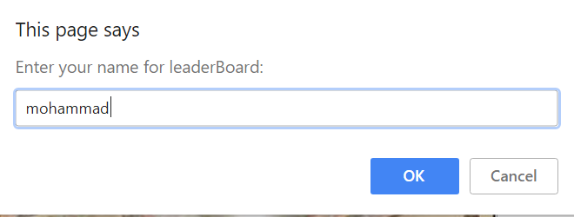

Rewards & the finish state
The Game offer two endings and both are featured as a reward so what are those endings:
If the user finishes the 3 levels with the Palestinian score higher the game will send a thank you message for saving Palestinian lives by supporting its economy.
LeaderBoard for high score .
If the user finishes with the Israeli score higher a thank you message for helping to kill Palestinian people by supporting Israel economy. ”this is a type of revers phycology”

Slide 8
